Slide 1



Rare Earth Metal Recovery from Waste Stream Using Algae
Alexa Rosenthal, Fethiye Ozis, Ph.D.
Department of Civil Engineering,
Construction Management, and Environmental Engineering

Slide 2
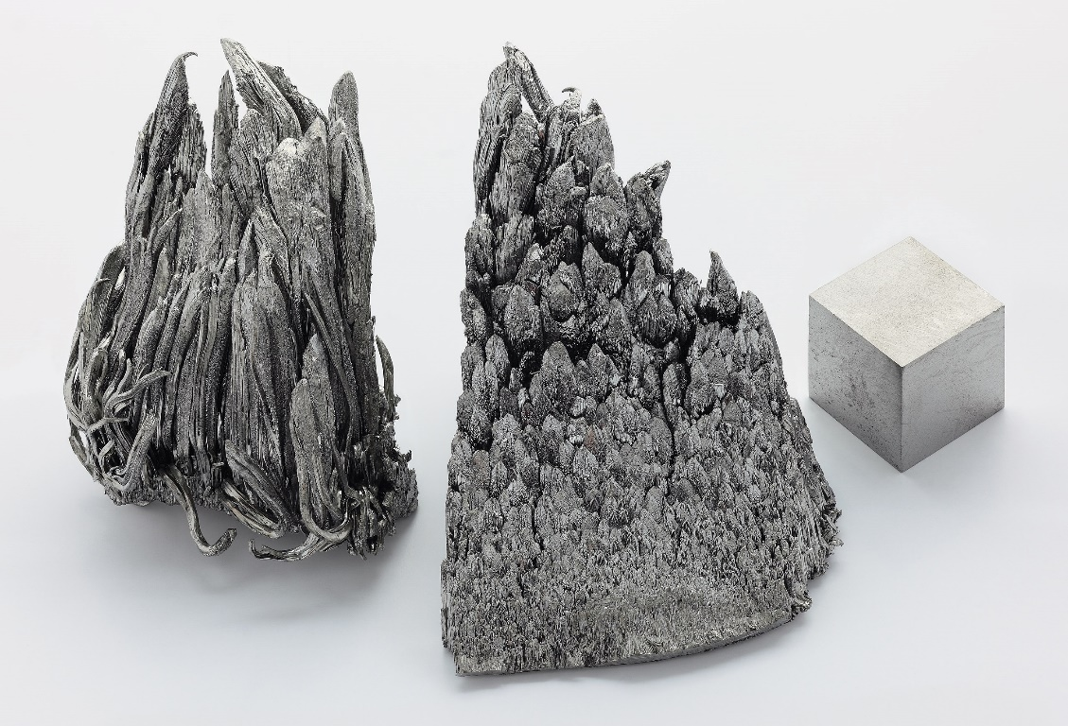
Introduction
Rare Earth Elements (REEs)¹
Modern technology
Increasing demand
Costly extraction
Adverse effects on the environment
Yttrium^{2,3}
Employed by NASA
Biosorption by Scenedesmus
Aluminum (Al³⁺) used as a substitute
Hypothesis: Algae will effectively sorb the metal and as algae mass increases, the removal efficiency increases.
Figure 1: Yttrium Metal⁴
[1] H. M. King, “REE - Rare Earth Elements and their Uses,” geology. [Online]. Available: https://geology.com/articles/rare-earth-elements/. [Accessed: 23-Feb-2020].
[2] “Yttrium - Element information, properties and uses: Periodic Table,” Yttrium - Element information, properties and uses | Periodic Table, 2020. [Online]. Available: https://www.rsc.org/periodic-table/element/39/yttrium. [Accessed: 02-Mar-2020].
[3] “blogs.nasa.gov,” blogs.nasa.gov, 21-Mar-2018.
[4] By Alchemist-hp (www.pse-mendelejew.de) - Own work, FAL, https://commons.wikimedia.org/w/index.php?curid=10793308
1

Slide 3
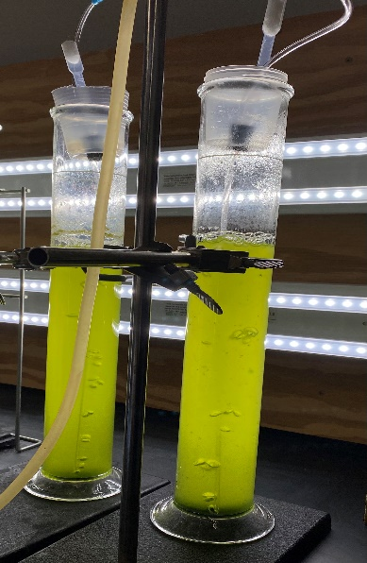
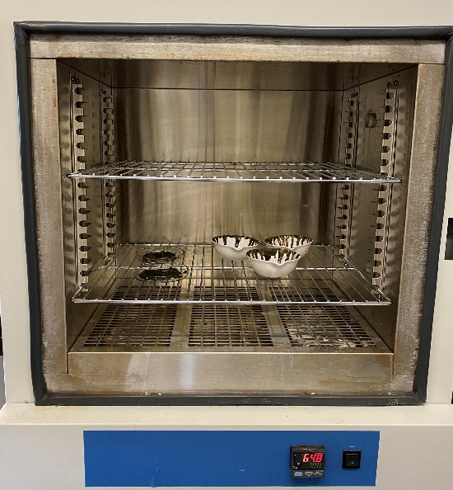
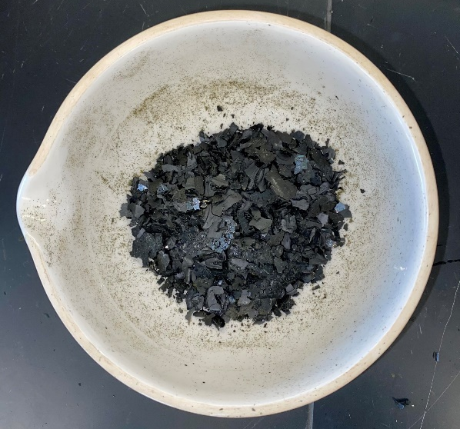
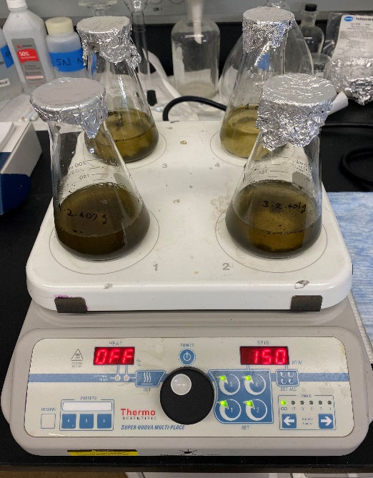
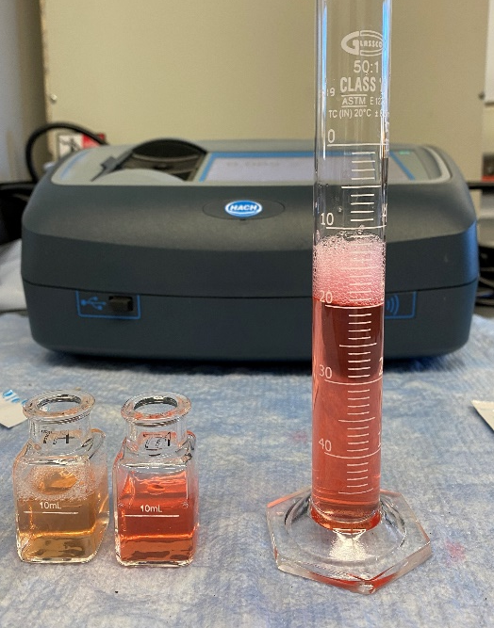
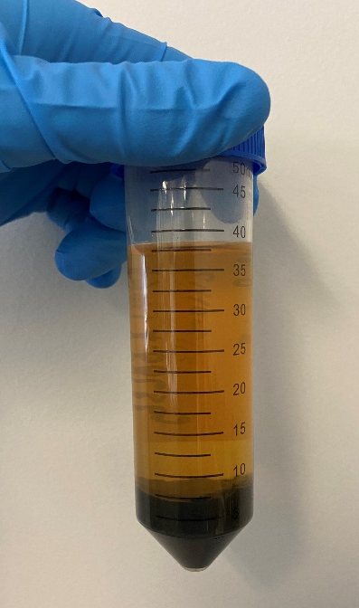
METHODOLOGY
1.
2.
3.
Algae cultures
Algae drying in drying oven
Dried algae
4.
5.
6.
Dried algae mixing in Al³⁺solution
Centrifuged sample
Testing for Al³⁺ concentration
2

Slide 4
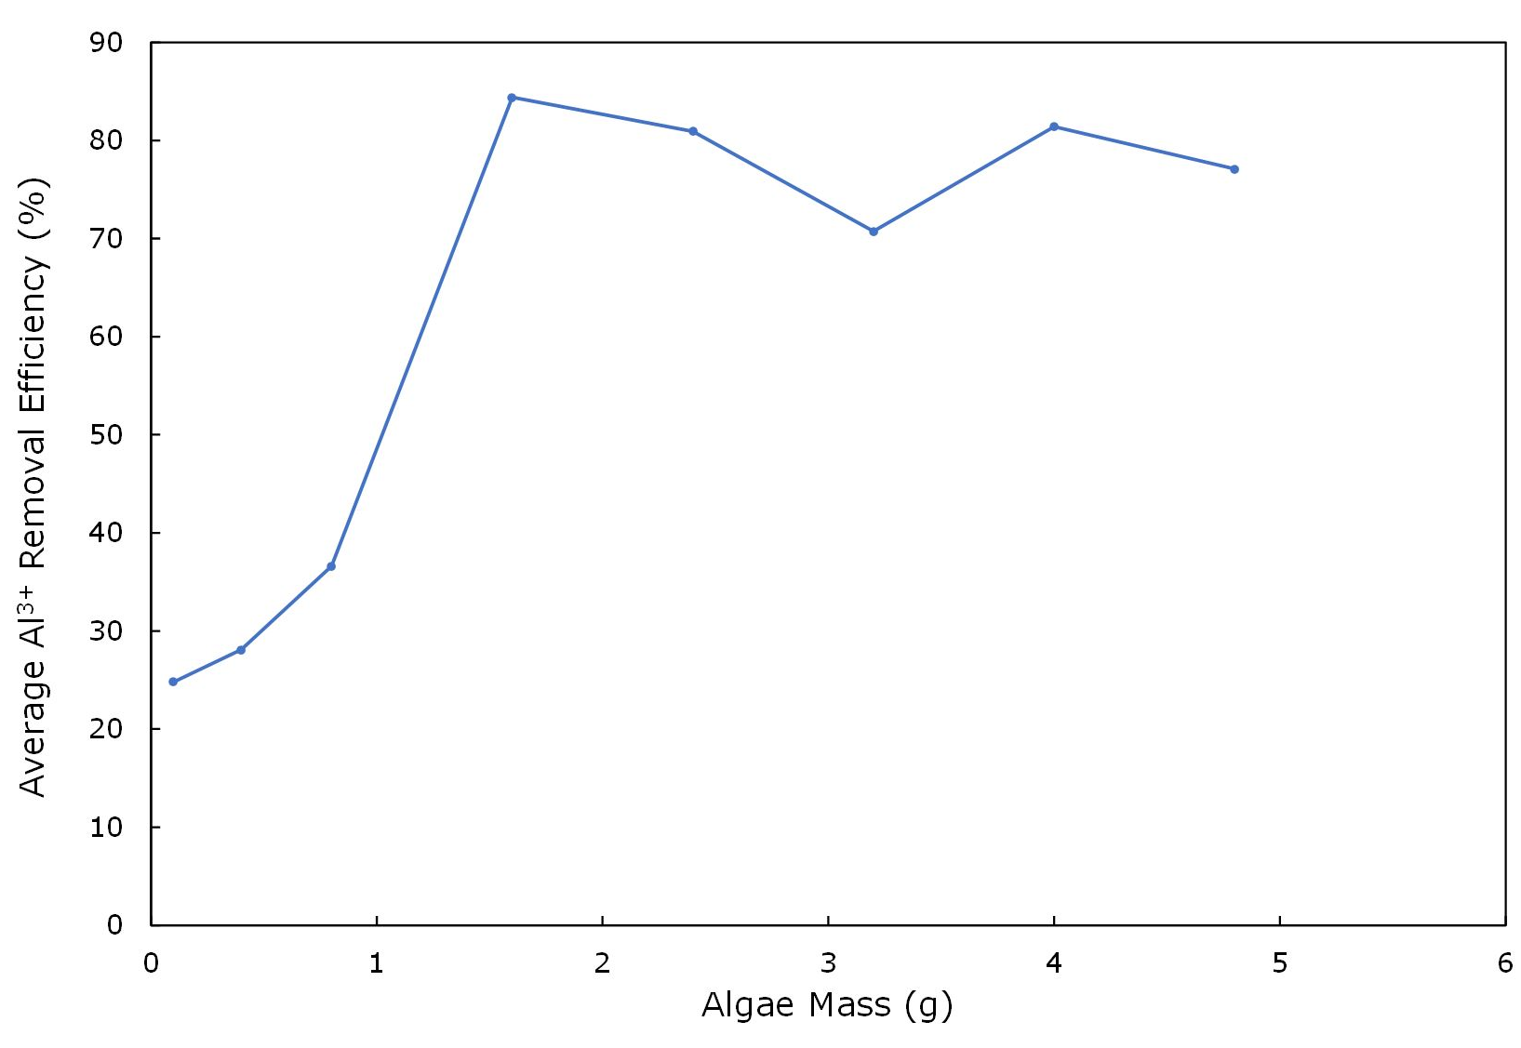
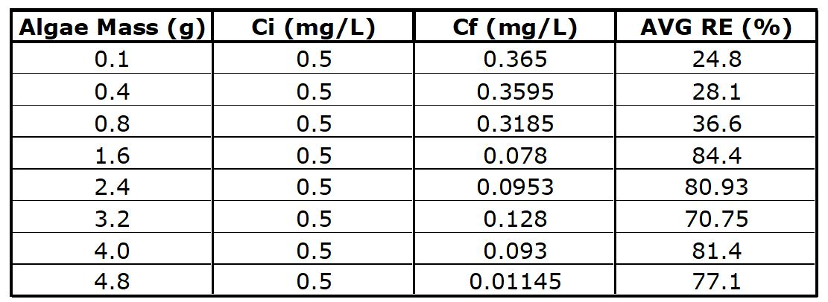
DATA ANALYSIS AND RESULTS
Table 1: Collected data on initial and final concentrations of Al³⁺ for each algae mass and observed average removal efficiencies
Figure 2: Average removal efficiency versus algae mass
3

Slide 5
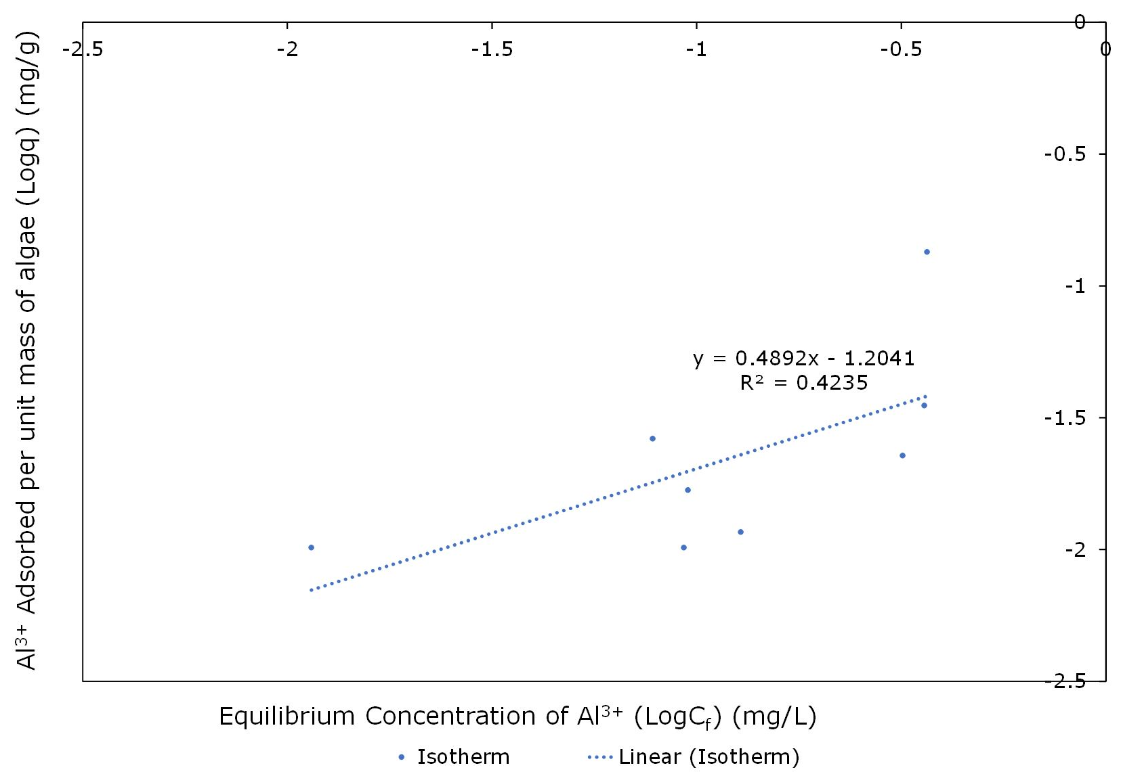
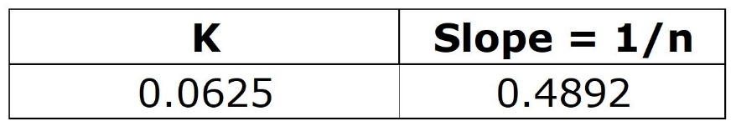
DATA ANALYSIS AND RESULTS⁵
Table 2: Isotherm of Biosorption Parameters
Figure 3: Isotherm of Biosorption (amount of metal adsorbed
per unit mass of algae (q) versus equilibrium concentration of Al³⁺ (C_{f}))
4
[5] J. R. Mihelcic and J. B. Zimmerman, Environmental Engineering: Fundamentals, Sustainability, Design, 2nd ed. John Wiley & Sons, Inc. , 2014.

Slide 6
CONCLUSION⁵
Table 1: Collected data on initial and final concentrations of Al³⁺ for each algae mass and observed average removal efficiencies
Freundlich isotherm intensity parameter = 1/n
Sorption of the Al³⁺ by algae is favorable
Recovery of yttrium by Scenedesmus is possible
Table 3: Isotherm of Biosorption Parameters
5
[5] J. R. Mihelcic and J. B. Zimmerman, Environmental Engineering: Fundamentals, Sustainability, Design, 2nd ed. John Wiley & Sons, Inc. , 2014.

Slide 7
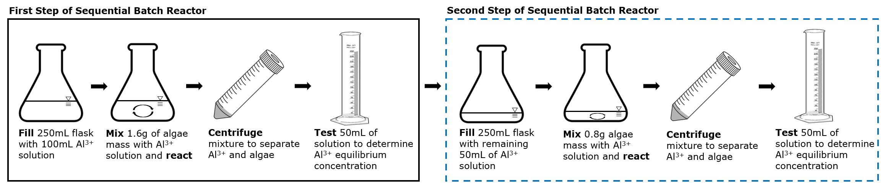
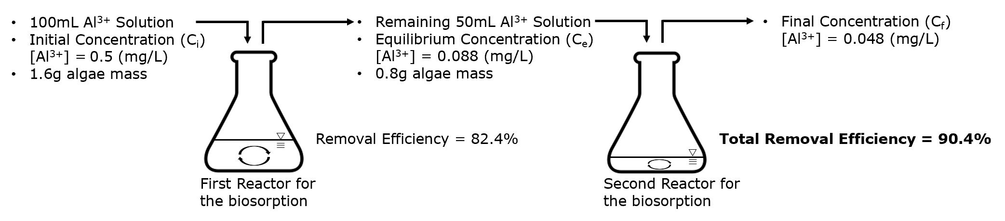
FUTURE RESEARCH
Figure 4: Sequential biosorption procedure
Figure 5: Overall Representation of Sequential Batch Reactors
6

Slide 8
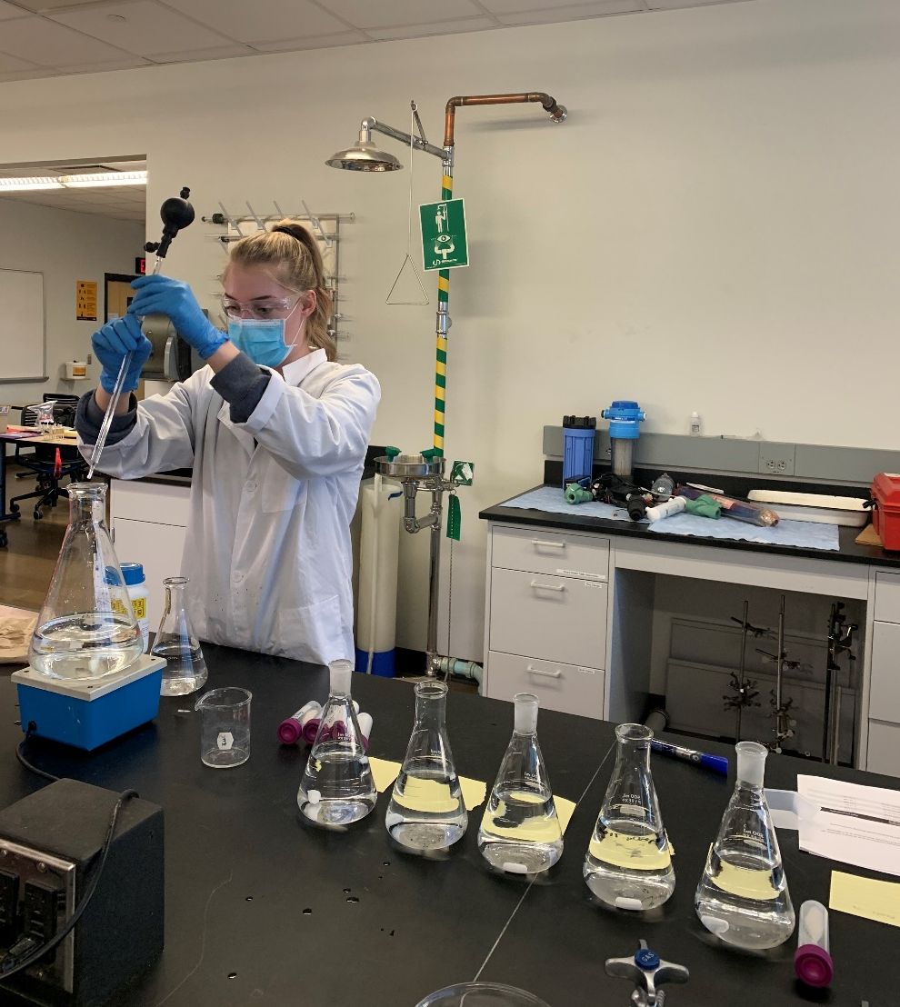
ACKNOWLEDGMENTS
NAU NASA Space Grant Program
Nadine Barlow, Ph.D.
Paloma Davidson
NAU Biology and Environmental Engineering
David John
Adam Bringhurst
Terry Baxter, Ph.D.
Thank you!
Figure 6: Making algae media in the lab
7

